Slide 1
Introduction to complexity theory

Slide 2
Why Computational Efficiency Still Matters?
Computers execute tasks extremely fast, but real-world problems can be too large to handle.
As computers advance, we attempt to solve bigger problems, keeping us limited by capacity.
Early computers were large,
but had far less computational power than modern smartphones.
Despite advancements, computational and memory constraints remain.
Hence, we need to analyze the efficiency of our program using “Complexity Theory”

Slide 3
Importance of Program Efficiency
Efficient programming is crucial due to limited computational resources.
In classroom settings, we almost never encounter this issue because the inputs to our problems are quite small.
As a result, even an inefficient program can process them very fast (in computer terms).
However, real-world problems involve massive inputs, making efficiency critical.
Poorly optimized (inefficient) programs can lead to
  Unacceptable execution times
  High memory consumption

Slide 4
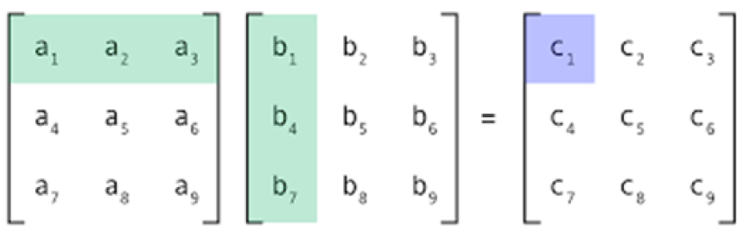
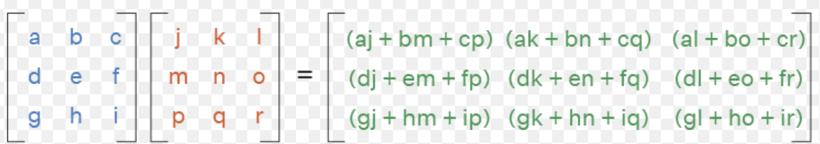
Example – Matrix Multiplication Complexity
Matrix multiplication: C = A × B, where C’s elements are computed using row-column multiplication.

Slide 5
Example – Matrix Multiplication Complexity
Matrix multiplication: C = A × B, where C’s elements are computed using row-column multiplication.
If A and B are 3 × 3 matrices:
  Each C element requires 3 multiplications, C has 9 elements
  Total multiplications = 3 × 9 = 27
  At 2 GHz CPU speed (~1 operation per nanosecond), takes ~27 nanoseconds.
    27 × 10^(-9) seconds = 27 nanoseconds.

Slide 6
Example – Matrix Multiplication Complexity
Matrix multiplication: C = A × B, where C’s elements are computed using row-column multiplication.
If A and B are 10,000 × 10,000 matrices:
  Each C element requires 10,000 multiplications.
  Total multiplications = 10^4×10^4×10^4=10^12
  At 2 GHz CPU speed (~1 operation per nanosecond), takes ~16.67 minutes.
    1012* 10^-9 seconds = 1000 seconds =16.67 minutes
Larger matrices drastically increase execution time.

Slide 7
Example – Memory Consumption Issue
Memory efficiency is crucial to avoid excessive resource usage.
For example:
  Bangladesh NID database has 50 million entries (~5×10^7).
  Each name: 20 characters
    So, for 50M entries of names→ 100 MB total ((5 X 10^7) X 20=10^9 bytes).
  If additional data is stored, memory usage can exceed 1 GB.
Problem: A simple program that loads the entire file into memory uses at least 100 MB
    May exceed 1 GB if additional data is included.
Concern: Personal computers have 8-16 GB RAM
  A single inefficient program can severely impact performance.

Slide 8
Understanding Time & Space Complexity
CPU time and memory space are scarce (limited) resources that must be used efficiently.
Two key measures of efficiency for a program:
  Time Complexity → How execution time grows with input size. (growth pattern)
  Space Complexity → How much memory the program consumes.
    The amount of memory an algorithm requires during execution.

Slide 9
Understanding Time & Space Complexity
Every event/algorithm can be analyzed under three scenarios:
Best Case:
  Minimum number of operations required
  minimum memory required.
Average Case:
  Expected number of operations
  typical memory required for a typical input.
Worst Case:
  Maximum number of operations required
  maximum memory required

Slide 10
Understanding Time & Space Complexity
Example: Identifying a Student from an Attendance Sheet
Scenario | Time Complexity | Space Complexity
Best Case | The student is the first entry → 1 comparison → O(1) | Only the first data item needs to be loaded → O(1)
Average Case | The student is found around the middle → approximately n/2 comparisons → O(n) | Approximately half of the data needs to be loaded → O(n)
Worst Case | The student is the last entry or not present → n comparisons → O(n) | All data must be loaded into memory → O(n).

Slide 11
Understanding Time & Space Complexity
Although algorithms can be analyzed under best-case, average-case, and worst-case scenarios, this course primarily focuses on the worst-case scenario.
Worst-case complexity helps determine:
  1) The maximum resource requirements (e.g., memory usage).
  2) The maximum execution time an algorithm may require.
Best-case and average-case complexity analyses will be covered in the Algorithms course.

Slide 12
Improving Worst-Case Performance of a Program
Small modifications can drastically improve performance.
Example: Searching in the NID database
  Naïve approach: Load the entire file into memory
      High memory usage (~1 GB).
  Optimized approach: Read one line at a time, compare, then discard if not a match
      Only 20~100 bytes needed.
  Performance gain: Stops searching early if a match is found,
      reducing execution time.
Most performance improvements require clever algorithms and data structures.
Thus, Data Structures & Algorithms (DSA) are core areas of computer science for this reason.

Slide 13
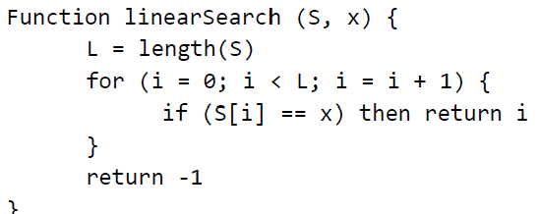
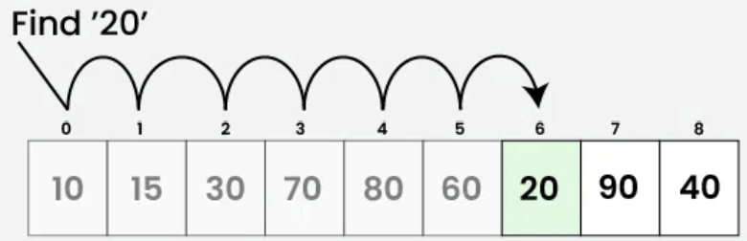
Linear/sequential Search
(Sentinel value)

Slide 14
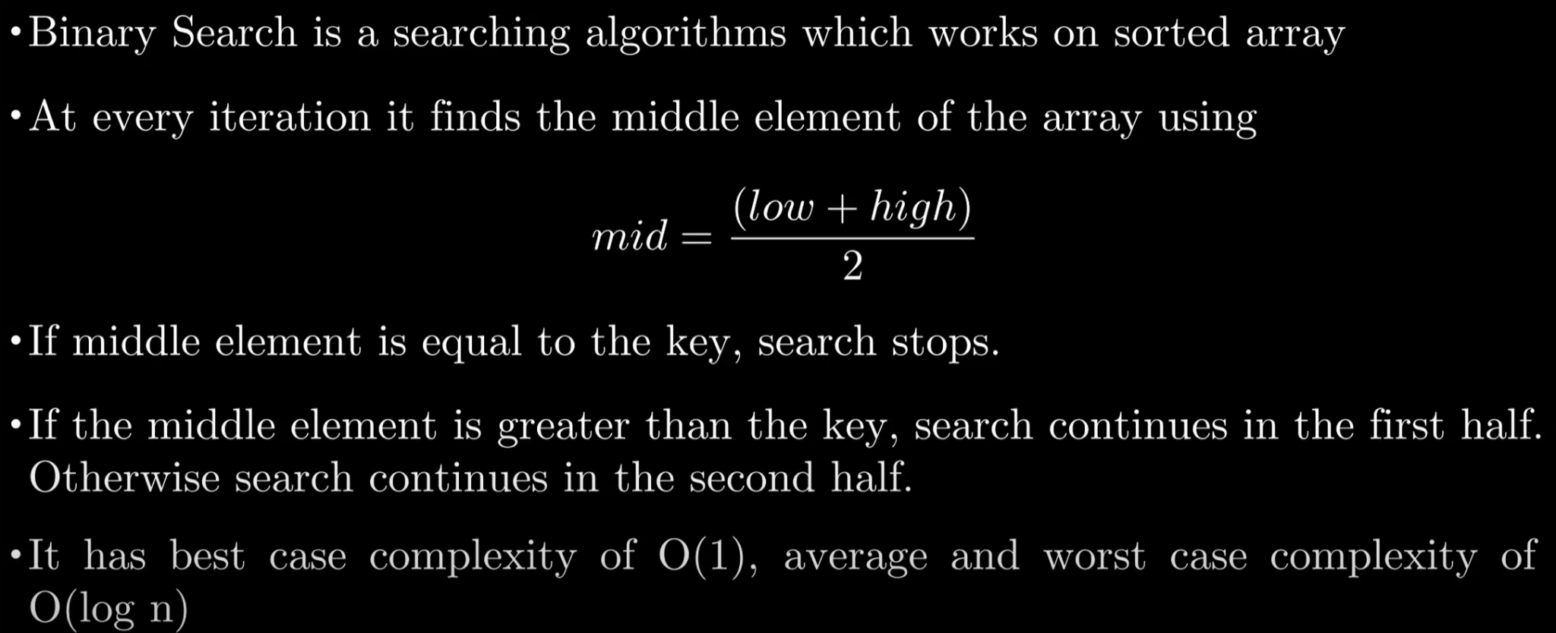

Binary Search [data sorted in ascending]

Slide 15
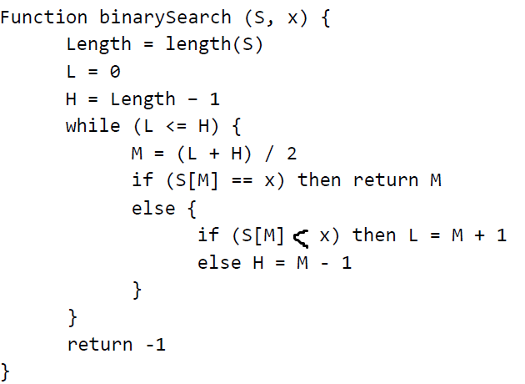
Binary Search [data sorted in ascending]

Slide 16
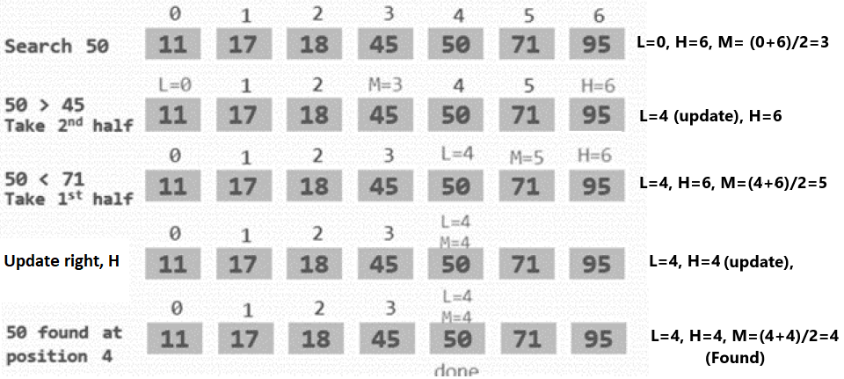

Slide 17
What if we were looking for 51?

Slide 18
What if we were looking for 51?
L= M+1=4+1=5,
H=4,
Here, L>H, LOOP break, return -1

Slide 19

Binary Search video
https://www.youtube.com/watch?v=kazvOikPQrk

Slide 20
Comparing Linear Search vs. Binary Search
Linear Search: O(N)
Directly checks each element.
Example: If N=1024, it takes 1024 comparisons.
Binary Search: O(log⁡₂N)
Cuts the search space in half each step.
Example: If N=1024, it only takes 10 comparisons (log⁡₂1024 = log⁡₂2¹⁰ = 10).
Key Takeaway:
Binary search is exponentially faster than linear search for large inputs.
Choosing the right algorithm can drastically improve performance.

Slide 21
Understanding Asymptotic Complexity
Asymptotic complexity describes how a program’s resource usage grows with input size N.
Example: If complexity is O(N^2), the actual time/space usage is C⋅N^2 for some constant C.
  The constant C depends on:
      Code implementation details.
      CPU architecture and operation costs.
      Data size and data structure.
We focus on how complexity scales rather than exact execution time.

Slide 22
Example – Linear Search Complexity
Operations in worst-case for input size N:
Compute length → 1 operation.
Increment loop index → N additions.
Compare index with length → N comparisons.
Load and compare elements → N+ N = 2N operations.
Return statement → 1 operation.
Total: 1+ N + N + 2N+ 1 = 4N+2 operations.
If another implementation takes 3N+2,
  It’s better, but constant differences don’t matter much.

Slide 23
Why Ignore Constant Factors in Complexity?
Compilers optimize execution, making small differences negligible.
Different CPU operations have varying execution costs, making exact timing unpredictable.
Hardware improvements make constant factor differences irrelevant over time.
What matters is how complexity grows with input size
rather than small efficiency differences.

Slide 24
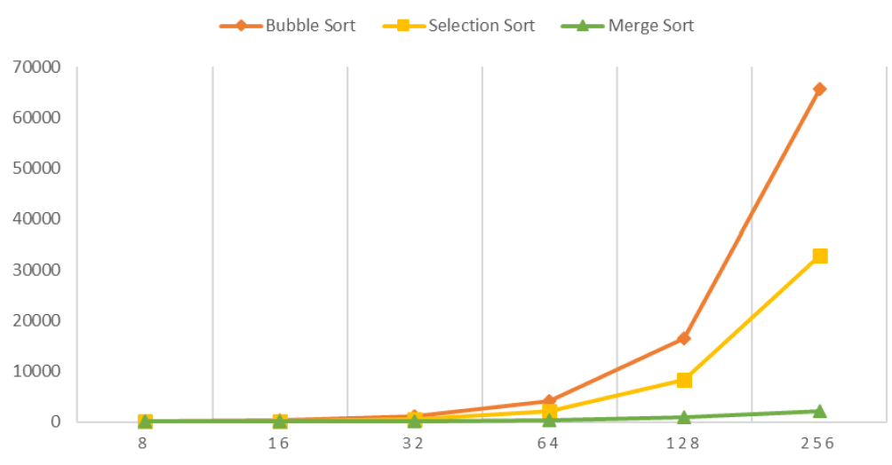
Comparing Sorting Algorithm Time Efficiency
Selection Sort: O(n^2), runs in (n(n+1))/2 time. [Pattern/growth trend same]
Bubble Sort: O(n^2), similar growth as selection sort. [Pattern/growth trend same]
Merge Sort: O(nlog⁡n) significantly faster for large inputs.
Time
Data

Slide 25
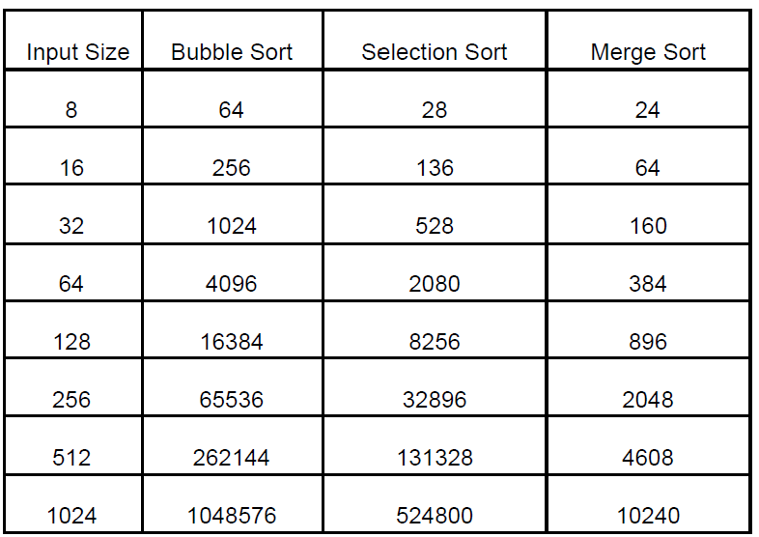
Comparing Sorting Algorithm Time Efficiency
Selection Sort: O(n^2), runs in (n(n+1))/2 time.
Bubble Sort: O(n^2), similar growth as selection sort.
Merge Sort: O(nlog⁡n) significantly faster for large inputs.
  For small inputs, all three perform similarly.
  As N grows, merge sort outperforms both selection and bubble sort.
  Constant factors are negligible; the dominant term determines efficiency.

Slide 26
Space Complexity of Bubble, Selection, and Merge Sort
Bubble Sort and Selection Sort are in-place sorting algorithms.
  They do not require any significant extra memory; only a constant amount of space is used for swapping elements.
  Therefore, their space complexity is O(1).
Merge Sort, requires extra memory for temporary subarrays during the merging process.
  The space needed for the subarrays is proportional to the input size (n).
  Thus, the space complexity of Merge Sort is also O(n).
Time complexity and space complexity are independent measures and should be analyzed separately.
Algorithms may have the same time complexity but different space complexities, and vice versa.

Slide 27
Understanding Big-O Notation
What is Big-O Notation?
It describes the worst-case time or space complexity of an algorithm as input size N grows to infinity.
It helps compare algorithms by focusing on their growth rate, ignoring
  1) Constant factors (Multiplicative & Additive)
  2) Lower-order terms
Example1 (constant factors): O(N)
  Linear search algorithm takes T(N) = 4N + 2 operations in the worst case.
    Multiplicative constants (4) are ignored because they don’t affect growth rate.
    Additive constants (+2) are insignificant for large N.
Example2 (lower-order terms):
  If time complexity is an^3 + bn^2 + cn + d,
    we write O(N^3) because N^3 dominates for large N.

Slide 28
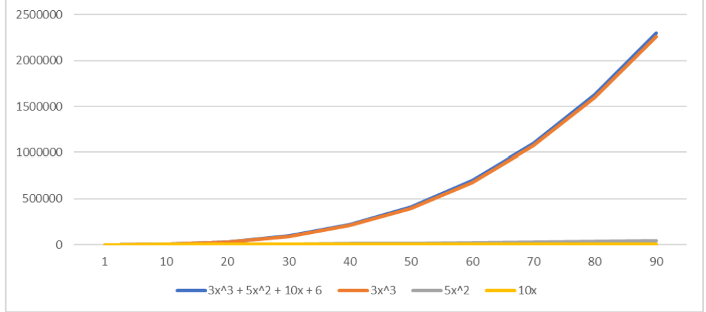
Understanding Big-O Notation
Ignores lower-order terms:
  3x^3+5x^2+10x+6 and 3x^3 have same time complexity
  5x^2 is 2nd lowest
  10x has the lowest
Time
Data

Slide 29
Understanding Big-O Notation
Ignores lower-order terms:
  3x^3+5x^2+10x+6 and 3x^3 have same time complexity O(N³)
  5x^2 is 2nd lowest O(N²)
  10x has the lowest O(N)
Time
Data

Slide 30
How to Read Big-O Notation (Mandatory)
Notation | Running time | Read as
O(1) | Constant time | Big O of one
O(log⁡N) | Logarithmic time | Big O of log n
O(N) | Linear time | Big O of n
O(Nlog⁡N) | Log-linear time | Big O of n log n
O(N^2) | Quadratic time | Big O of n squared
O(N^3) | Cubic time | Big O of n cubed
O(2^N) | Exponential time | Big O of two to the power of n
O(N!) | Factorial time | Big O of n factorial
Note: Big-O notation may also be read informally as “order of n,” “order of n squared,” and so on.
However, “Big O of n,” “Big O of n squared,” etc. are the more precise and technically accurate readings.

Slide 31
Typical Running Time Functions (Important! Remember!!)
1 (constant running time):
  Instructions are executed once or a few times
logN (logarithmic)
  A big problem is solved by cutting the original problem in smaller sizes, by a constant fraction at each step
  Shortcut: the number that is used for division or multiplication will be the base of log
N (linear)
  A small amount of processing is done on each input element
N logN
  A problem is solved by dividing it into smaller problems, solving them independently and combining the solution

Slide 32
Typical Running Time Functions (Important! Remember!!)
N² (quadratic)
  Typical for algorithms that process all pairs of data items (double nested loops)
N³ (cubic)
  Processing of triples of data (triple nested loops)
N^{K} (polynomial), 2^{N} (exponential)
  Few exponential algorithms are appropriate for practical use

Slide 33
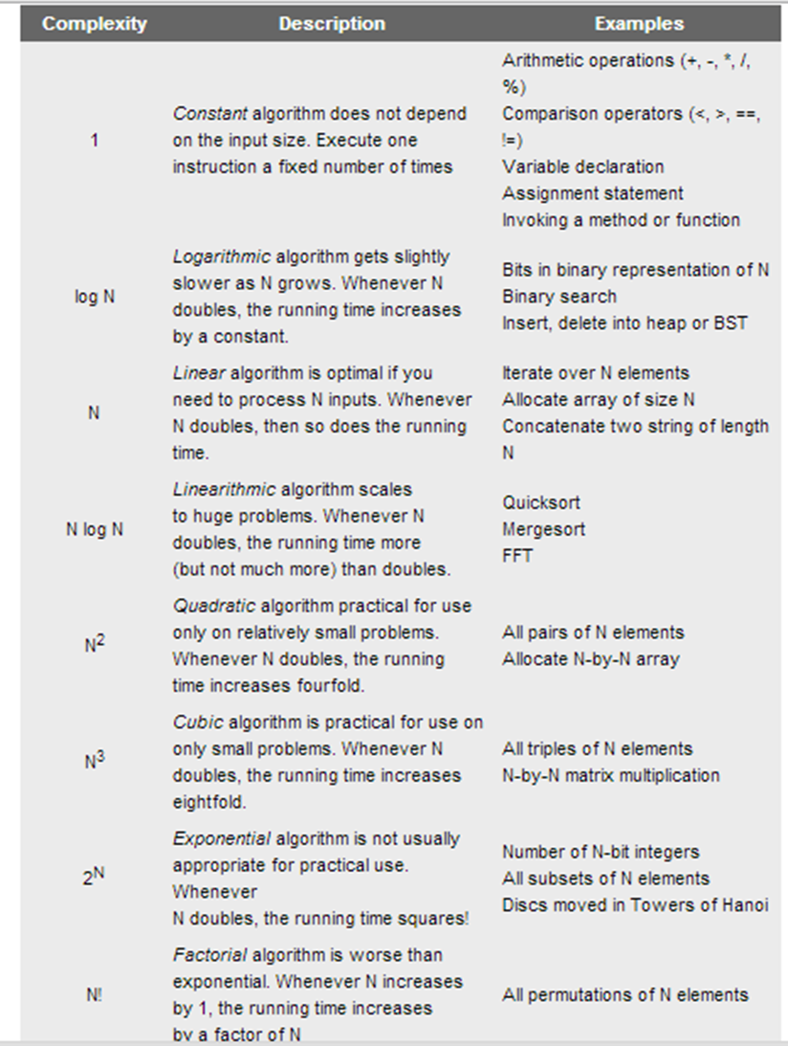

Slide 34
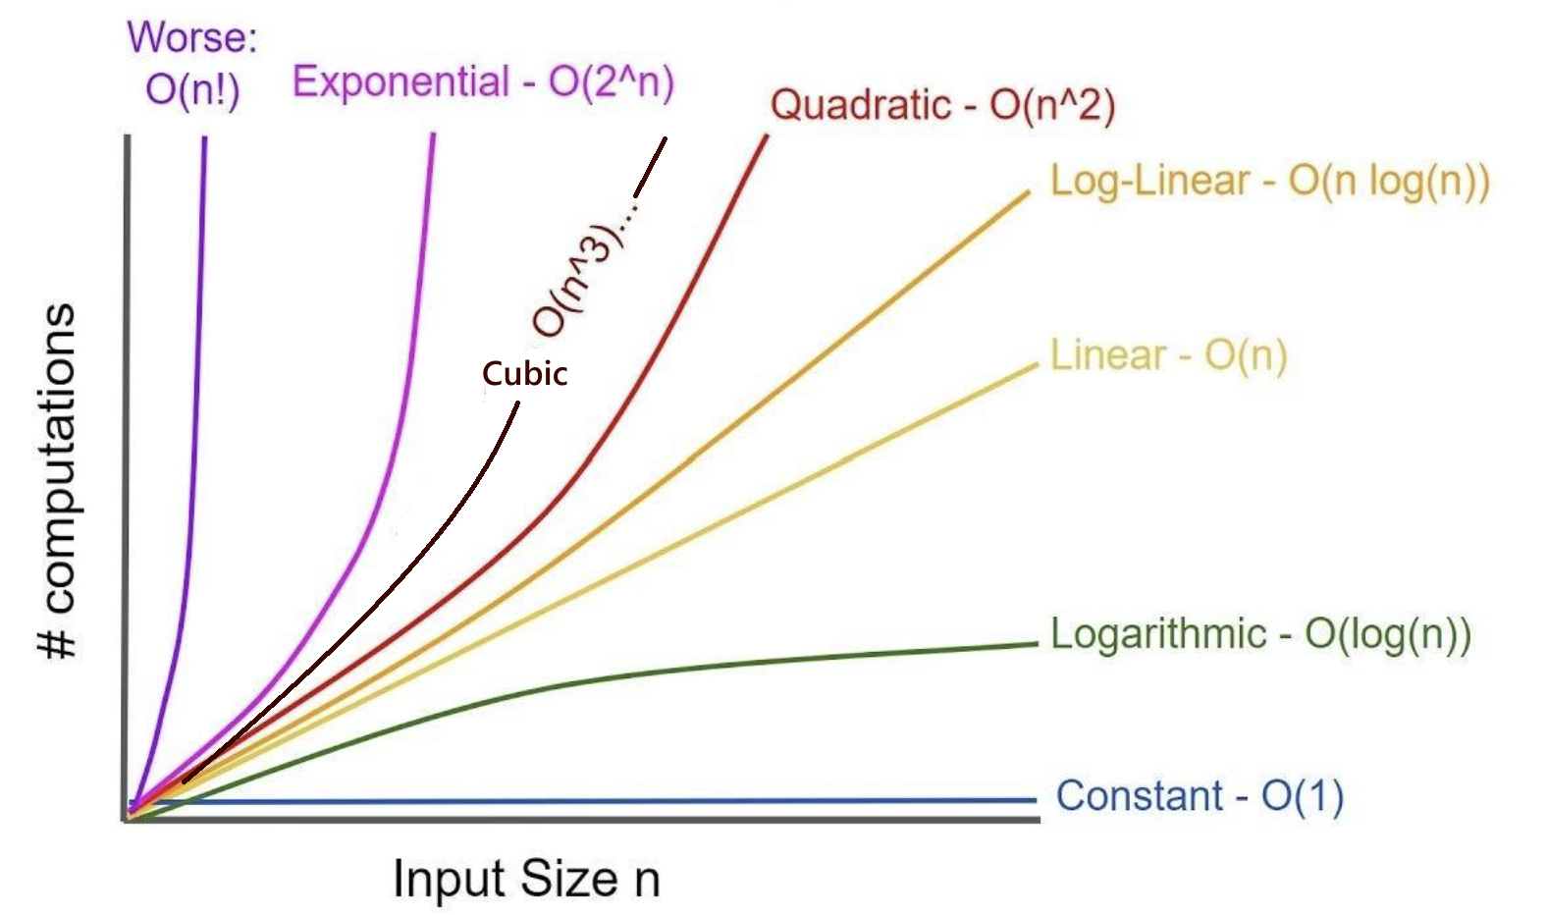
Typical Running Time Functions (Important! Remember!!)

Slide 35
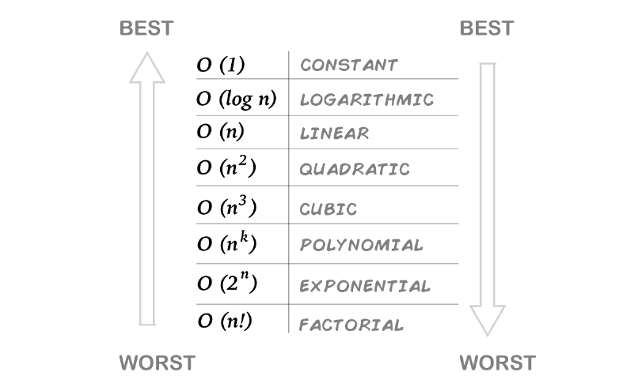
Typical Running Time Functions (Important! Remember!!)

Slide 36
Example01
Code:
a = b;
Time complexity: ?
Space complexity: ?

Slide 37
Example01
Code:
a = b;
Time complexity: O(1)
Space complexity: O(1) — Since it's a simple value assignment

Slide 38
Rules (Important! Remember!!)
If nested, multiply.
If sequential (in a single line), add.
Constant factors: 2 types –Remove them
  Multiplicative
  Additive
Lower-order terms – Remove them
Shortcut for constant: If it can be counted on your fingers, treat it as O(1).
  Compared to large inputs, we are ignoring small values.

Slide 39
Example02
Code:
int sum = 0; n = 100;
for (i=1; i <=n; i++){
sum += n;
}
Time complexity: ?
Space complexity: ?

Slide 40
Example02
Code:
int sum = 0; n = 100; O (1)
for (i=1; i <=n; i++){ // O (n)
sum += n; O (1)
}
Time complexity: O (1) + O (n) X O (1)
= O (1) + O (n)
= O (n)
Space complexity: O(1) — The loop runs O(n) times, but no extra space is used apart from a few variables, making it constant space.

Slide 41
Example03
Code:
int sum1 = 0, n = 100;
for (i=1; i<=n; i++){
for (j=1; j<=n; j++){
Sum1++;
}
}
Time Complexity: ?
Space complexity:??

Slide 42
Example03
Code:
int sum1 = 0, n = 100; O(1)
for (i=1; i<=n; i++){ O(n)
for (j=1; j<=n; j++){ O(n)
sum1++; O(1)
}
}
Time complexity: O(1) + O(n) x O(n) x O(1) = O(n²)
Space complexity: O(1) — only a few integer variables are used, requiring constant space.

Slide 43
Example04
Code:
sum1 = 0, n = 100;
for (i=1; i<=n; i++) {
for (j=1; j<=2*n; j++){
sum1++;
}
}
Time complexity:??
Space complexity:??

Slide 44
Example04
Code:
sum1 = 0, n = 100; O(1)
for (i=1; i<=n; i++){ O(n)
for (j=1; j<=2*n; j++){ O(2n) = O(n)
sum1++; O(1)
}
}
Time complexity: O(1) + O(2n) x O(n) = O(n²)
Space complexity: O(1)

Slide 45
Example05
Code:
sum = 0; n = 100;
for (j=1; j<=n; j++) {
for (i=1; i<=j; i++){
Sum++;
}
}
for (k=0; k<n; k++){
s = k;
}
Time complexity: ?
Space complexity:??

Slide 46
Example 05
sum = 0, n = 100; O(1)
for (j=1; j<=n; j++){ O(n)
for (i=1; i<=j; i++){ O(n), max value of j is n
Sum++; O(1)
}
}
for (k=0; k<n; k++){ O(n)
s = k; O(1)
}
Time complexity: O(1) + O(n²) + O(n) = O(n²)
Space complexity: O(1)
O(n)* O(n) * O(1) = O(n²)
O(n)* O(1) = O(n)

Slide 47
Example06
Code:
sum1 = 0;
n = 100;
for (k=1; k<=n; k*=2){ // k = k*2
for (j=1; j<=n; j++){
Sum1++;
}
}
Time complexity: ??
Space complexity:??

Slide 48
Example06
Code:
sum1 = 0; O(1)
n = 100; O(1)
for (k=1; k<=n; k*=2){ //k starts at 1 and doubles each time
//= O(log₂n)
for (j=1; j<=n; j++){//j runs from 1 to n = O(n)
Sum1++; O(1)
}
}
Time complexity: O(1) + O(1) + O(log₂n) x O(n) = O(nlog₂n)
Space complexity: O(1)

Slide 49
Example06
Code:
sum1 = 0;
n = 100;
for (k=1; k<=n; k*=2){ // k= 1 2 4 8 16 32 64
= total 7 time loop runs
for (j=1; j<=n; j++){
Sum1++;
}
}
Time complexity: O(log₂n) x O(n) = O(nlog₂n)
log₂(100) = 6.67 = approx 7

Slide 50
Example07
Code:
sum1 = 0;
n = 100;
for (i=n; i>=1; i=i/2) {
for (j=1; j<=n; j++){
sum1= sum1 + i ;
}
}
Time complexity: ?
Space complexity:???

Slide 51
Example07
Code:
sum1 = 0; O(1)
n = 100; O(1)
for (i=n; i>=1; i=i/2){ //i starts at n and is halved each time
//= O(log₂n)
for (j=1; j<=n; j++){//j runs from 1 to n = O(n)
Sum1= Sum1 + i ; O(1)
}
}
Time complexity: O(1) + O(1) + O(log₂n)x O(n) = O(nlog₂n)
Space complexity: O(1)

Slide 52
Example07
Code:
sum1 = 0;
n = 100;
for (i=n; i>=1; i=i/2){ // i= 100 50 25 12 6 3 1 = total 7 times
for (j=1; j<=n; j++){ O(n)
sum1= sum1 + i ; O(1)
}
}
Time complexity: O(log₂n)x O(n) = O(nlog₂n)
log₂(100) = 6.67 = approx 7

Slide 53
Example08
Code:
a=0;
N= 50;
i=N;
while (i>0){
a = a+ i;
i = i/2 ;
}
Time complexity: ??
Space complexity:??

Slide 54
Example08
Code:
a=0 ;
N= 50;
i=N;
while (i>0){
a = a+ i; O(1)
i = i/2; //i starts at N and is halved each time = O(log₂n)
}
Time complexity: O(log₂n)X O(1) = O(log₂n)
Space complexity: O(1)

Slide 55
Example09
Code:
sum1 = 0;
n = 100;
for (i=n; i>=1; i=i/2) {
for (k=1; k<=n; k*=2){
sum1= sum1 + i ;
}
}
Time complexity: ??
Space complexity:??

Slide 56
Example09
Code:
sum1 = 0; O(1)
n = 100; O(1)
for (i=n; i>=1; i=i/2){ O(log₂n)
for (k=1; k<=n; k*=2){ O(log₂n)
sum1= sum1 + i ; O(1)
}
}
Time complexity: O(log₂n)x O(log₂n)x O(1) = O((log₂n)²)
Space complexity: O(1)

Slide 57
Example10
sum1 = 0;
n = 50;
for (i=0; i<=n; i=i+1) {
for (k=0; k<=i*n; k=k+1) {
sum1 = sum1 + i ;
}
}
for (i=0; i<=n+n; i=i+1) {
sum1= sum1 + i;
}
Time complexity: ???
Space complexity:??

Slide 58
Example10
sum1 = 0; O(1)
n = 50; O(1)
for (i=0; i<=n; i=i+1){ O(n)
for (k=0; k<=i*n; k=k+1){ O(n²), max value of i is n
sum1= sum1 + i ; O(1)
}
}
for (i=0; i<=n+n; i=i+1){ O(2n)= O(n)
sum1= sum1 + i ; O(1)
}
Time complexity: O(1) + O(1) + O(n³) + O(n) = O(n³)
Space complexity: O(1)
O(n)* O(n²) = O(n³)

Slide 59
Multi-Parameter Complexity [examples in analysis 11, 12]
When input has multiple attributes, complexity depends on all relevant factors.
Example: Processing a dataset with N records, each having M features → O(N+M).
Some problems require expressing complexity in terms of multiple input sizes.
  We will see details later

Slide 60
Example11
Code:
sum1 = 0; n = 100; m = 50;
for (i=n; i>=1; i=i-1){
for (k=1; k<=m; k=k+2){
sum1= sum1 + i + k ;
}
}
for (i=1; i<=m; i=i+1){
print(i) ;
}
Time complexity: ??
Space complexity:???

Slide 61
Example11
Code:
sum1 = 0; n = 100; m = 50;
for (i=n; i>=1; i=i-1){ O(n)
for (k=1; k<=m; k=k+2){ O(m/2)= O(m)
// k goes from 1 to 50 in steps of 2 → 25 iterations
sum1= sum1 + i + k ; O(1)
for (i=1; i<=m; i=i+1){ O(m)
print(i) ; O(1)
}
Time complexity: O(n)x O(m)x O(1) + O(m)x O(1)
= O(n x m) + O(m)
= O(n x m)
Space complexity: O(1)

Slide 62
Example12
Code:
ArrayList<Integer> arr = new ArrayList<>(); // This is an empty list
int counter=0, N=100, M=40;
for (i=1; i<=N; i=i+1){
arr.add(i); Inserting values to empty list
}
for (i=1; i<=M; i=i+1){
counter+=1;
}
Time complexity: ????
Space complexity:???

Slide 63
Example12
ArrayList<Integer> arr = new ArrayList<>(); O(1)
int counter=0, N=100, M=40; O(1)
for (i=1; i<=N; i=i+1){ O(N)
arr.add(i); O(1)
}
for (i=1; i<=M; i=i+1){ O(M)
counter+=1; O(1)
}
Time complexity: O(1)+ O(1)+ O(N)x O(1)+ O(M)x O(1)
= O(2)+ O(N) + O(M)
= O(N) + O(M)
= O(N+M)

Slide 64
Example12
ArrayList<Integer> arr = new ArrayList<>(); This is an empty list
int counter=0, N=100, M=40;
for (i=1; i<=N; i=i+1){
arr.add(i); Inserting values to empty list
}
for (i=1; i<=M; i=i+1){
counter+=1;
}
Space complexity:???

Slide 65
Example12
ArrayList<Integer> arr = new ArrayList<>(); O(1)
int counter=0, N=100, M=40; O(1)
for (i=1; i<=N; i=i+1){O(N), because N number of elements are being inserted.
So, space requirement is N
arr.add(i);
}
for (i=1; i<=M; i=i+1){ O(1): Space needed for local variables only
counter+=1;
}
Space complexity:
= O(1) + O(1) + O(N) + O(1)
= O(N)

Slide 66
Example13
Code:
int[] arr = new int[n];
for (int i = 0; i < n; i++) {
arr[i] = i;
}
Time complexity: ???

Slide 67
Example13
Code:
int[] arr = new int[n]; O(n)
for (int i = 0; i < n; i++) { O(n)
arr[i] = i; O(1)
}
Time complexity: O(n) + O(n)x O(1)
= O(n)

Slide 68
Example13
Code:
int[] arr = new int[n]; O(n)
for (int i = 0; i < n; i++) { O(1)
arr[i] = i; O(1)
}
Space complexity: O(n) + O(1)x O(1)
= O(n)

Slide 69
Example14
Code:
int[][] matrix = new int[n][n];
for (int i = 0; i < n; i++) {
for (int j = 0; j < n; j++) {
matrix[i][j] = i + j;
}
}
Time complexity: ?????

Slide 70
Example14
Code:
int[][] matrix = new int[n][n]; O(n²)
for (int i = 0; i < n; i++) { O(n)
for (int j = 0; j < n; j++) { O(n)
matrix[i][j] = i + j; O(1)
}
}
Time complexity: O(n²) + O(n)x O(n)
= O(n²) + O(n²)
= O(2n²)
= O(n²)

Slide 71
Example14
Code:
int[][] matrix = new int[n][n]; O(n²)
for (int i = 0; i < n; i++) { O(1)
for (int j = 0; j < n; j++) { O(1)
matrix[i][j] = i + j; O(1)
}
}
Space complexity: O(n²) + O(1) x O(1) x O(1)
= O(n²)

Slide 72
Example15
Code:
int i, j, k = 0, n=100;
for (i = n / 2; i <= n; i++) {
for (j = 2; j <= n; j = j * 2) {
k = k + n / 2;
}
}
Time complexity: ???

Slide 73
Example15
Code:
int i, j, k = 0, n=100; O(1)
for (i = n / 2; i <= n; i++) { O(n/2)= O(n),
//loop runs from n/2 to n time, total runs n/2 times
for (j = 2; j <= n; j = j * 2) { O(log₂n)
k = k + n / 2; O(1)
}
}
Time complexity: O(1) + O(n)x O(log₂n) x O(2)= O(nlog₂n)

Slide 74
Example16
Code:
int i, j;
Assume, A[] is an array and has n=10 integer elements
if (condition) { // Suppose condition is true in some cases
for (i = 0; i < n; i++) {
a[i] = i + 2;
}
}
else {
for (i = 0; i < n; i++) {
for (j = 0; j < n; j++) {
a[i] = a[j] + 1;
}
}
}
Time complexity: ???

Slide 75
Example16
The focus of this example is the if-else statement. When calculating the time complexity, ignore the code before the red border.
Code:
int i, j;
Assume, A[] is an array and has n=100 integer elements
if (condition) { // Suppose condition is true in some cases
for (i = 0; i < n; i++) { // O(n)
a[i] = i + 2; // O(1)
}
}
else {
for (i = 0; i < n; i++) { // O(n)
for (j = 0; j < n; j++) { // O(n)
a[i] = a[j] + 1; // O(1)
}
}
}
Time complexity: O(n)xO(1) + O(n)xO(n)xO(1)
= O(n) + O(n²)
= O(n²)

Slide 76
Example16
Code:
int i, j;
Assume, A[] is an array and has n=100 integer elements
if (condition) { // Suppose condition is true in some cases
for (i = 0; i < n; i++) {
a[i] = i + 2;
}
}
else {
for (i = 0; i < n; i++) {
for (j = 0; j < n; j++) {
a[i] = a[j] + 1;
}
}
}
Without considering the array declaration part,
Space complexity: O(1)
[No extra space is used apart from loop variables.]
Considering the array declaration part,
Space complexity: O(n)

Slide 77
Example17 [Optional, skip if you want]
Code:
int i, j, k = 0, n=100;
for (i = 1; i <= n; i = i * 2) {
for (j = 1; j <= i; j = j + 1) {
k ++;
}
}
Time complexity: ??????

Slide 78
Example17 [Optional, skip if you want]
Code:
int i, j, k = 0, n=100; O(1)
for (i = 1; i <= n; i = i * 2) { // i = 1, 2, 4, 8, 16, 32, 64 //O(log₂n)
for (j = 1; j <= i; j = j + 1) { // O(n) = putting the last value of i (64) which is close to n
k ++; O(1)
}
}
Time complexity: O(1) + O(log₂n) x O(n) x O(1)= O(nlog₂n) ?????
But, how many times inner loop is actually running?
Is it really O(n)?

Slide 79
Example17 [Optional, skip if you want]
Code:
int i, j, k = 0, n=100; O(1)
for (i = 1; i <= n; i = i * 2) { // i = 1, 2, 4, 8, 16, 32, 64 //O(log₂n) = 7 times
for (j = 1; j <= i; j = j + 1) { // 1 + 2 + 4 + 8 + 16 + 32 + 64 = 127 times
k ++; O(1)
}
}
Time complexity: O(n)
// total execution time for k++ is (1 + 2 + 4 + 8 + 16 + 32 + 64) =127 ≈(close to) 100 (n)
Hence, the total time needed is close to n, not n log n.

Slide 80
Example17 [Optional, skip if you want]
Code:
int i, j, k = 0, n=100; O(1)
for (i = 1; i <= n; i = i * 2) { // i = 1, 2, 4, 8, 16, 32, 64 //O(log₂n) = 7 times
for (j = 1; j <= i; j = j + 1) {
k ++;
}
}
Time complexity: O(n) [Correct answer]
// 1 + 2 + 4 + 8 + 16 + 32 + 64 = 127 times
= 2⁰ + 2¹ + 2² + 2³ + 2⁴ + 2⁵ + 2⁶ +......2^{n} (Geometric series) = 2n - 1
= O (2n - 1)
= O (n)

Slide 81
Practical Use of Asymptotic Complexity
Ignoring Constants:
  Asymptotic complexity ignores constant multipliers and additive factors.
  However, constant coefficients of different powers of N may matter in real-world applications.
Estimating Resource Requirements
Used to estimate the time and space costs of a program for large input sizes.
Helps in selecting the most efficient implementation.

Slide 82
Practical Use of Asymptotic Complexity (Example)
Example: Space Complexity Limitation
  Two implementations have C₁ * n log₂n and C₂ * n log₂n same time complexity (Same).
  Assume:
    RAM size = 32GB
    Understanding the Input Size:
      The maximum input size is 512M = 2²⁹ entries.
      Each entry is 1 byte, so storing all entries would take 2²⁹ bytes (≈ 512MB)
    Computing Memory Requirement for Processing:
      The time complexity given is n log₂n.
      For n = 2²⁹, we compute: nlog⁡₂n= (2^29)×(30)
        Here, log₂(2²⁹) = 29, so we assume an additional small factor (≈ 30) for overhead.
      Approximate: 2²⁹×30 ≈ 2²⁹×2x15 ≈ 2³⁰×15
      Since 2³⁰ bytes = 1GB, Memory requirement is 15GB

Slide 83
Practical Use of Asymptotic Complexity (Example)
Example: Space Complexity Limitation
  Two implementations have C₁ * n log₂n and C₂ * n log₂n time complexity (Same).
  Assume:
    RAM size = 32GB
    Max input size = 512M (≈ 2²⁹) entries of 1 byte each
    n log₂n = 2²⁹ * 30 ≈ 15GB [Memory requirement]
    Impact of Constants (C₁ and C₂):
If C₁ = 2, the required space is = 2×15 GB=30 GB
  This fits within the available 32GB RAM
If C₂ = 3, the required space is = 3×15GB=45 GB
  This exceeds the available 32GB RAM, making execution impossible
  First implementation is the only viable option.

Slide 84
Practical Use of Asymptotic Complexity
Time vs. Space Tradeoff
  Optimization dilemma:
    Improving time efficiency may require extra memory to store additional data and speed up access.
    Improving space efficiency may reduce memory usage but can make the algorithm slower due to less efficient algorithms or extra resource management steps.
  Real-world impact: Some problems require balancing time and space efficiency based on constraints.

Slide 85
The End

